Slide 1
IMDB Movie Analysis
Using PowerBI

Slide 2
Objective
Determining the factors influence the success of a movie on IMDB
A data set is given which has to be cleaned and analysis has to be made using PowerBI

Slide 3
Technologies used:
Python→ a high level programming language
PowerBi→is a collection of software services, apps, and connectors that work together to turn your unrelated sources of data into coherent, visually immersive, and interactive insights

Slide 4
Steps done in this project:
Understanding problem statement
Data extraction
Data cleaning
EDA
Data analysis

Slide 5
Data extraction
Data is extracted using
DATASET LINK: https://drive.google.com/file/d/1bXz_ksbuLRFP9wDZBE53MyeQi2Ko54PI/view? usp=sharing

Slide 6
Data cleaning
[Action, Adventure, Fantasy, Sci-Fi]
[Action, Adventure, Fantasy, Sci-Fi]
Data set has null values and column like genres are in list format (eg., [action | comedy| romantic| thriller]
Geners has been treated using strsplit and explode
Null-imputation: done using
Bfill
Ffill
Mean replacement ‘
Median replacement
Replacement on Ratio basis
Replacement done using groupby etc.,

Slide 7
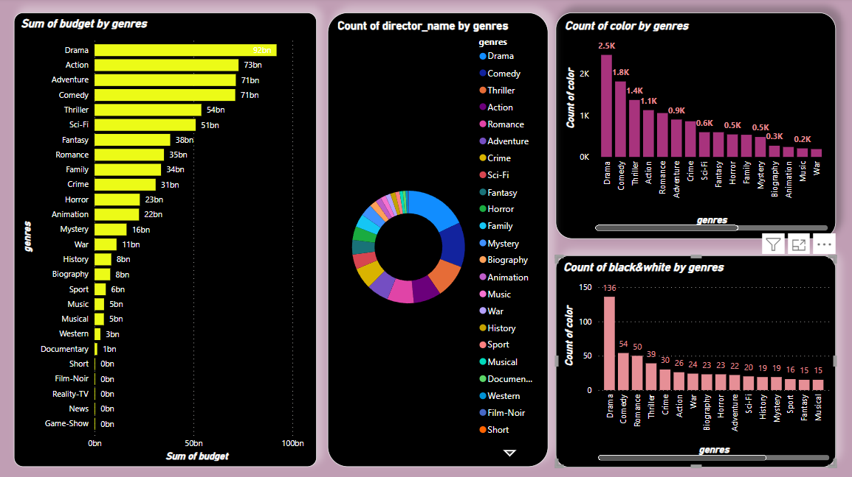
Data analysis
This chart shows
the budget spend for each genres
Number of directors directed in different genres
Count of movies in color and black &white in different genres

Slide 8
Analysis of above charts
Color movies are most popular than black and white
Budget used to direct comedy movies are less

Slide 9
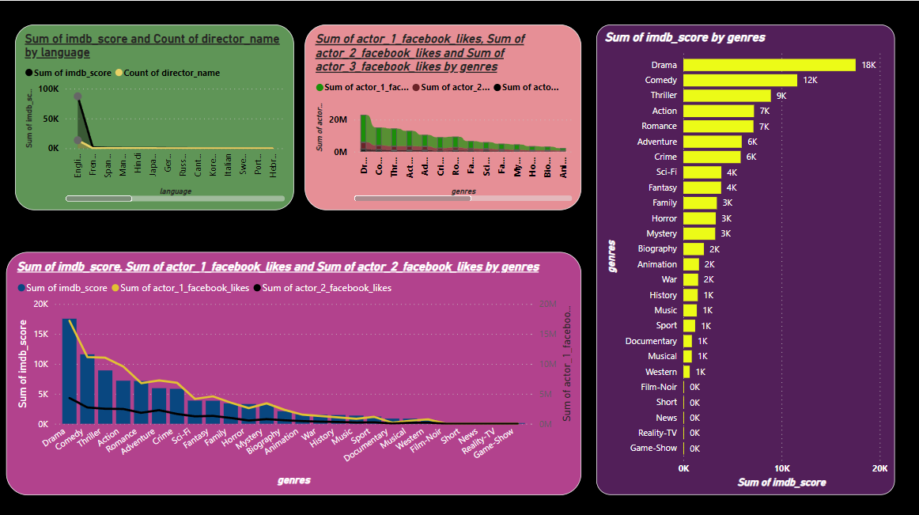
Data analysis as per actors FB likes
This charts shows the impact of actors fblikes and IMDB score
Fb likes of actor 1 has great impact on IMDB score

Slide 10
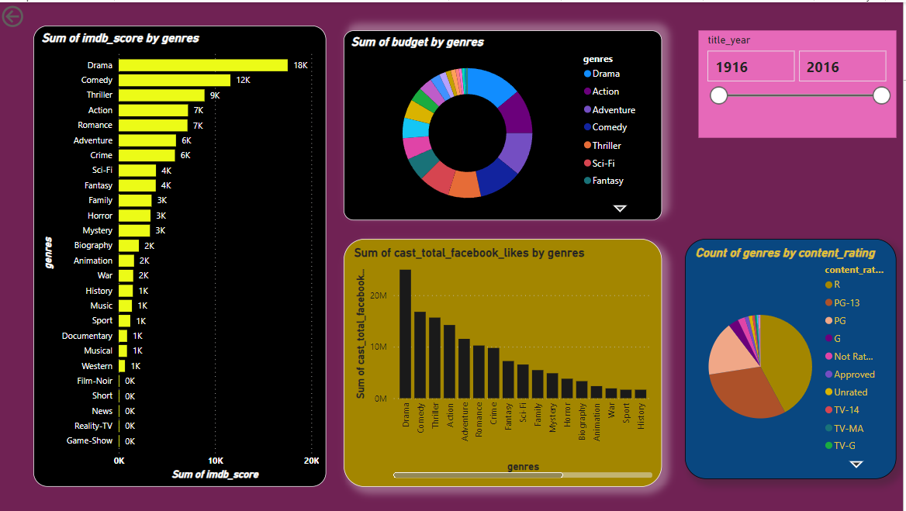
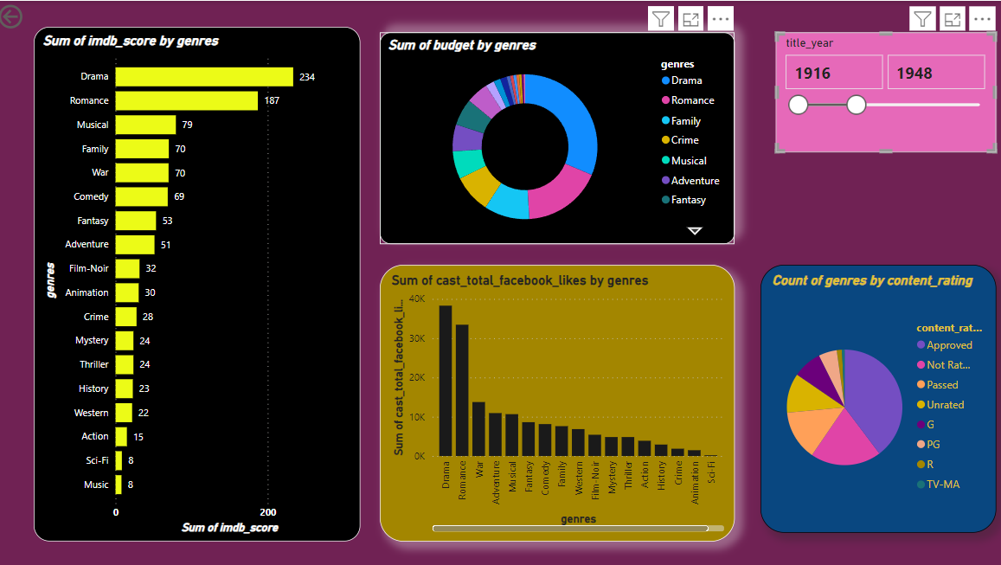
Data analysis –showing relationship between budget,cast FB likes and IMDB score

Slide 11
Data analysis –showing relationship between budget,cast FB likes and IMDB score
Though budget has a minimal impact on IMDB score ,it’s the cast FB likes that exactly has a strong positive relationship with IMDB score
If we notice by year , drama always stand first
But likes for romance was high during 1916 to 1948

Slide 12
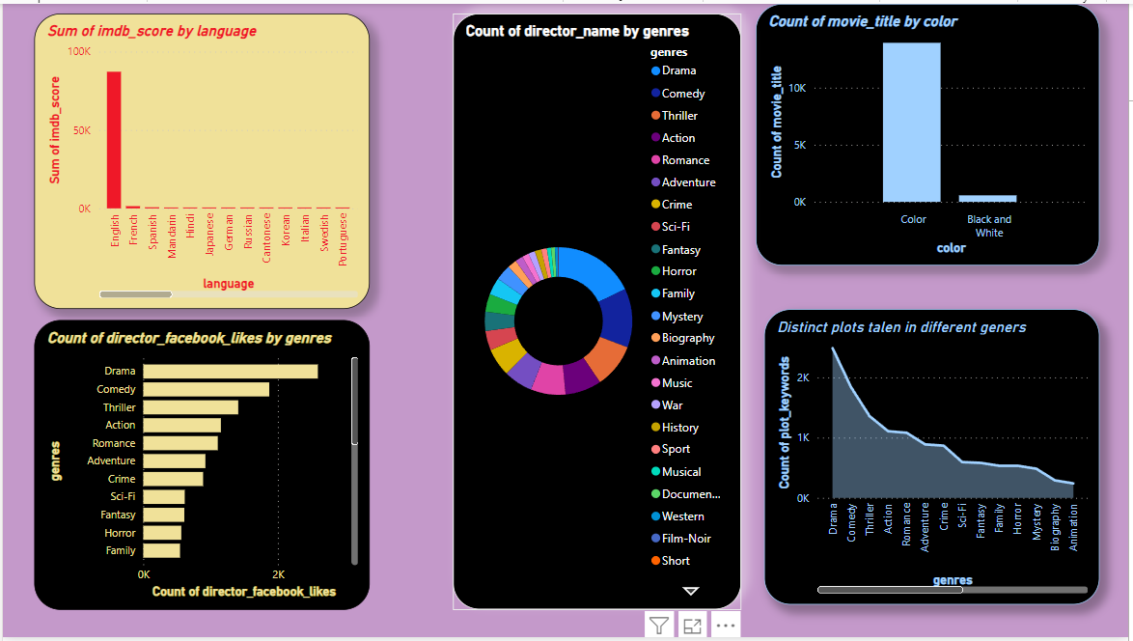
Data analysis on language , director impact on IMDB score
English language movies have high imdb score than any other language
Its drama genre which has high distinct plot

Slide 13
NOTE:
I have mentioned my analysis near to the chart itself

Slide 14
Thank You

